Slide 1
FINNECT: From Mandate to Magnet
Transforming the FINRA Office into a Hub of Connection
Yankun Song
June 11, 2025
Notes:
Good afternoon, everyone. Today, I want to talk about a fundamental shift in our workplace and a powerful opportunity that comes with it. I’m calling this transformation 'From Mandate to Magnet,' and it's about how we can turn our FINRA offices into true hubs of connection.

Slide 2

The High Cost of Disengagement: A Silent Drain
Disengaged employees cost U.S. firms $450B+ annually
Employee replacement costs up to 200% of annual salary
51% of U.S. workers actively job searching (decade low engagement)
Notes:
So, let's start with the problem, because ignoring engagement has a steep and measurable cost. Disengagement is a silent drain on our resources. Annually, it costs U.S. firms over 450 billion dollars in lost productivity alone. When disengaged employees inevitably leave, the cost to replace them can be staggering—up to double their annual salary, depending on the role. This isn't a future problem; it's an urgent one. Right now, U.S. employee engagement is at a decade low, and over half the workforce is actively looking for a new job. The risk to our stability and bottom line is clear and present.

Slide 3

The Engagement Advantage: Performance Multiplier
Reduces turnover by up to 46%
Engaged employees 5x less likely to quit
Less burnout, fewer mental health days
Notes:
But on the other side of that risk lies a powerful opportunity. Proactively fostering engagement isn't just about mitigating loss; it's a performance multiplier. The data shows that engaged teams see a massive reduction in turnover—up to 46% in some cases. More importantly, it builds loyalty. An employee who feels connected and valued is five times less likely to quit. This creates a more stable, committed, and ultimately healthier workforce, with fewer instances of burnout and absenteeism. This is the strategic advantage we are aiming for.

Slide 4

The Complication: Our RTO Policy is a Catalyst
Mandatory 2-day/week hybrid policy is now in effect.
This shift creates new logistical and social friction.
We must provide tools to make in-office time a strategic asset.
Notes:
So, with that business case in mind, let's turn to our current situation. This year, we implemented our mandatory Return-to-Office policy. This is a critical juncture. It's an opportunity to strengthen our culture, but it also introduces new friction. If we don't manage this transition proactively, we risk making our offices feel like an obligation rather than a destination. This is our moment to choose: we can either let challenges like employee isolation grow, or we can provide the tools to make our in-office time a powerful, strategic asset

Slide 5

The Human Cost: David's 2-Hour Commute to Isolation
Represents colleagues in cross-office teams.
In-office days are lonely; no network, no connections.
Risk: RTO policy could inadvertently decrease engagement.
Notes:
To understand this friction, let's talk about David. David is not a hypothetical case; he represents many of our colleagues. His team is in Rockville, but he commutes over two hours to the Dallas office to meet the RTO requirement. But what happens when he gets there? He spends the day in isolation. He doesn't know anyone, so lunch is eaten alone, and the spontaneous collaborations we want to foster just don't happen. His experience highlights a critical risk: our policy could inadvertently make our people feel more disconnected, not less.

Slide 6

The Everyday Disconnects: Small Frictions, Big Impact
The Silent Start: Awkward silence before meetings begin.
The Invisible New Hire: Hesitant to network or find mentors.
The Unfulfilled Break: No easy way to find an activity partner.
Notes:
And David's story is just one example. These disconnects are happening every day in small, corrosive ways. Think about the awkward silence at the start of a virtual or hybrid meeting—a prime moment for connection, lost. Think of a new hire, eager to build their network but too shy to approach strangers. Or an employee who wants to play table tennis on a break but has no easy way to find a partner, so they just stay at their desk. These aren't huge problems on their own, but together, they erode our culture.

Slide 7
The Central Question for FINRA
How do we solve the logistical friction for employees like David?
How do we eliminate the small, everyday disconnects?
How do we make our RTO policy a driver of culture?
Notes:
This brings us to our central question: How do we solve this? How do we bridge the gap for David and eliminate these everyday disconnects? How do we transform our RTO policy from a logistical challenge into a powerful driver of engagement and culture at FINRA?

Slide 8
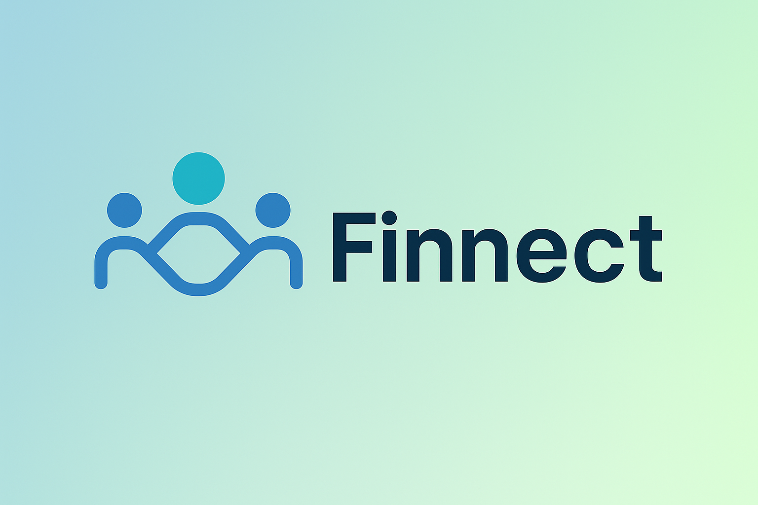
The Answer: Finnect, Our Hybrid Engagement Engine
A strategic digital platform to solve our hybrid challenges.
Engineered to make in-office time intentional and engaging.
Transforms the office from an obligation to a destination.
Notes:
The answer is Finnect. Finnect is our proposed hybrid work engagement portal. It’s a strategic digital platform designed specifically to solve these challenges. It’s not just another app; it’s an ecosystem engineered to make our in-office time intentional, collaborative, and genuinely engaging. It’s the tool that turns our offices from a place people have to be, into a place they want to be.

Slide 9
Finnect: Live Demo
A quick look at the user experience and key features.
Notes:
Now, rather than just tell you about it, I'd like to show you. In this brief demo, I'll walk you through the key features of the Finnect portal and how it directly addresses the problems we've discussed.

Slide 10
How Finnect Works: Four Core Features
Looking for Pals: Connects employees for lunch, coffee, or carpooling.
Clubs: Empowers employees to build communities around shared interests.
News & Icebreaker Hub: Provides easy, ready-made conversation starters.
Smart Chatbot: Instantly answers questions about events without browsing.
Notes:
As you just saw, Finnect works by targeting our specific pain points. The 'Looking for Pals' feature directly solves David's problem—and the table tennis problem—by connecting employees for lunch, coffee, or carpooling. The 'Clubs' feature empowers our new hires to find their tribe, building communities around shared interests. And the 'News & Icebreaker Hub' solves the silent meeting problem by providing a constant stream of easy conversation starters. It’s simple, intuitive, and effective. Plus, our Smart Chatbot instantly answers questions about pals and clubs, eliminating the need to browse through countless posts. It's simple, intuitive, and effective.

Slide 11

The Result: A More Connected & Collaborative FINRA
Fosters innovation by breaking down cross-departmental silos.
Improves morale and sense of belonging.
Provides the support structure to ensure our hybrid model succeeds.
Notes:
The result is a more connected and collaborative FINRA. By breaking down silos, we foster innovation. By making it easy to build relationships, we improve morale and an employee's sense of belonging. And critically, we provide the support structure needed to make our hybrid model a resounding success.

Slide 12

Q&A

